Slide 1
MLMQ Mat Luke Message Queuing
Advanced Systems Lab – Milestone 1
Matthias Ganz & Lukas Elmer
HS 13/14
ETHZ

Slide 2
Agenda
Design
Overview
Middleware
Database
(Design Decisions)
Experiments
Setup
Summary
Results (Factors) (2^{k} Test)
2h Trace
Lessons Learned about the System

Slide 3
Design

Slide 4
Design – Overview
Client
Client
Client
Middleware
Database
Client
Client
Client
TCP IP Sockets
Middleware
JDBC
Client
Client
Client
Middleware

Slide 5
Design – Middleware
Middleware
Request Queue
NIO
DB Connection Pool
Client
Database
Client
Client
Client
Client
Worker
Response Queue
Buffer Pool

Slide 6
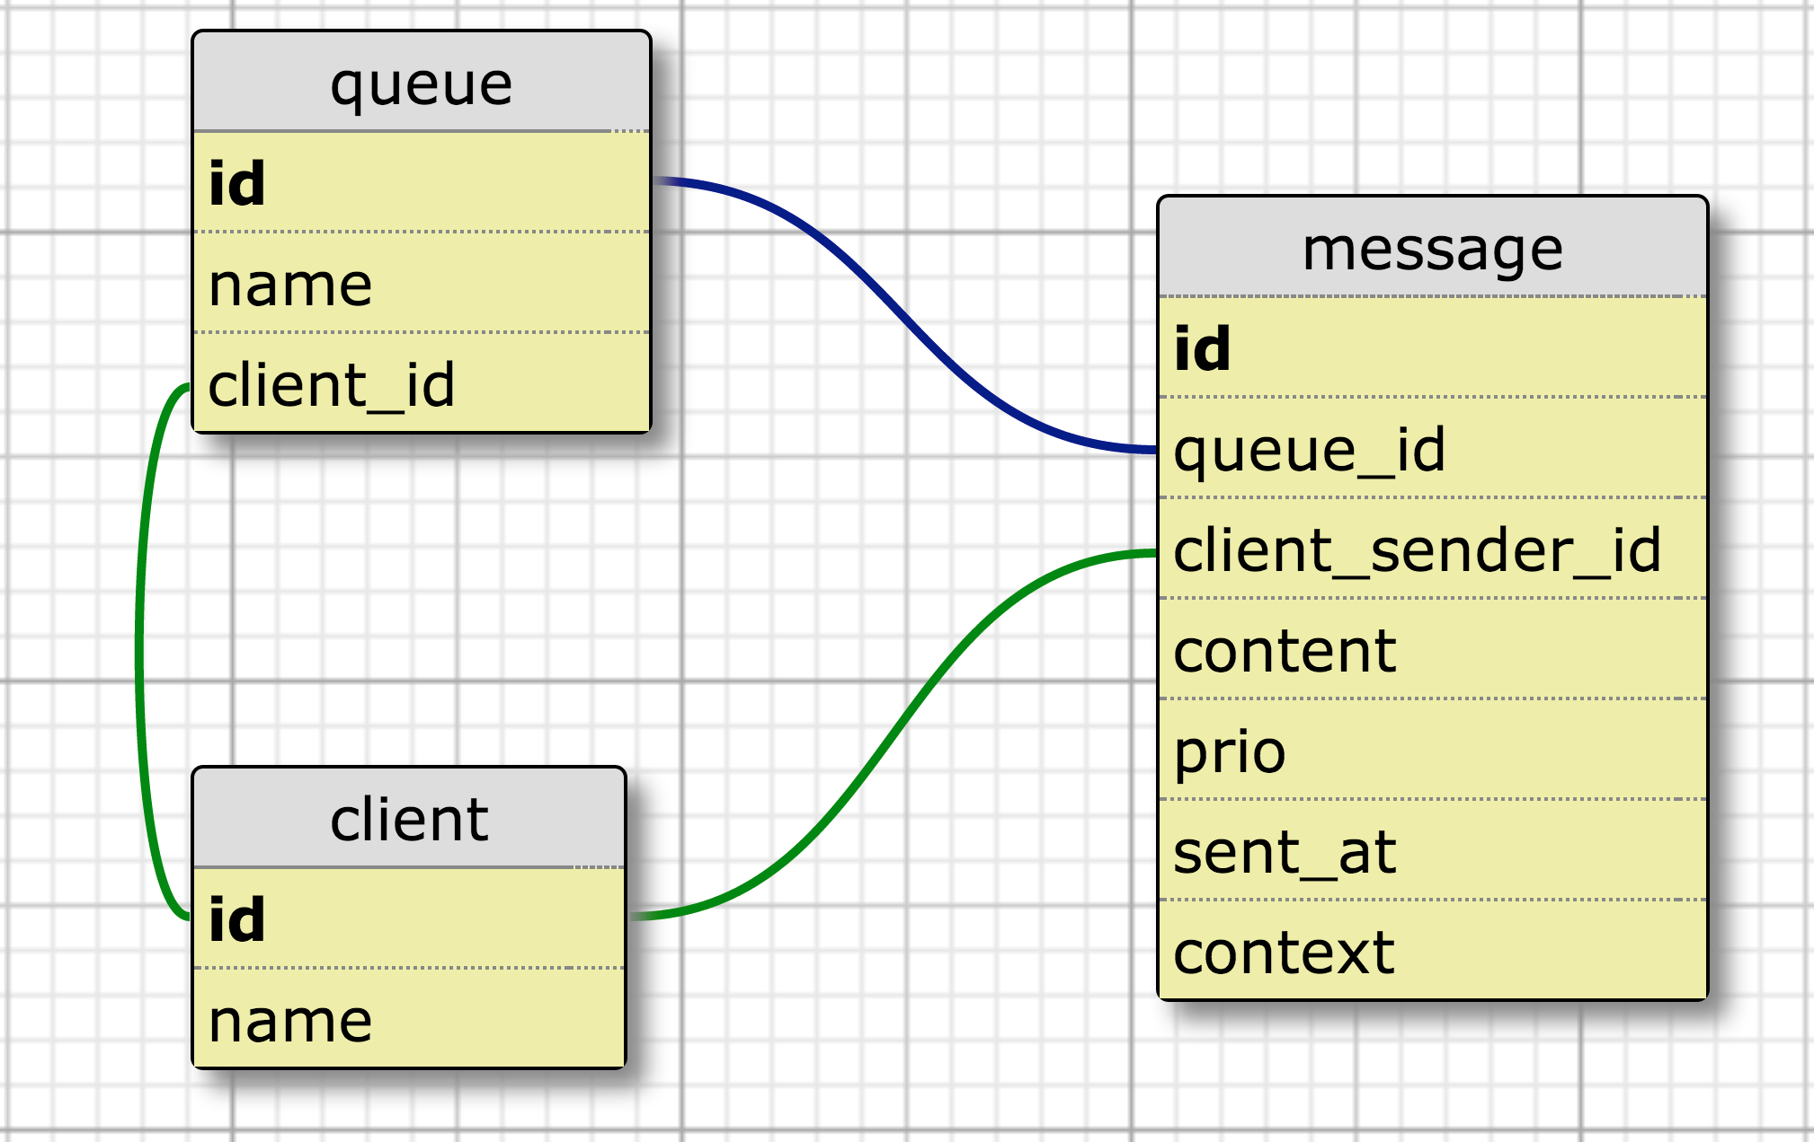
Design – Database

Slide 7
Design – Database
Indices (B-Trees)
Queue: client_id
Client: name
Message: queue_id, prio, sent_at, client_sender_id, context
Stored procedures
peekMessage

Slide 8
Design – Interface
ClientDto register()
ClientDto lookupClient(String clientName)
QueueDto lookupClientQueue(long clientId)
QueueDto createQueue(String queueName)
QueueDto lookupClientQueue(String queueName)
void deleteQueue(long id)
void sendMessage(long queueId, byte[] content, int prio)
void sendMessage(long[] queueIds, byte[] content, int prio)
void sendMessageToClient(long clientId, byte[] content, int prio)
long sendRequestToClient(long client, byte[] content, int prio)
long sendResponseToClient(long clientId, long context, byte[] content, int prio)
int queuesWithPendingMessages(List<QueueDto> queues, int maxNumQueues)
MessageDto peekMessage(MessageQueryInfoDto messageQueryInfo)
MessageDto dequeueMessage(MessageQueryInfoDto messageQueryInfo)

Slide 9
Experiments

Slide 10
Experiments – Setup

Slide 11
Experiments – Summary
???

Slide 12
Experiments – Results

Slide 13
Experiments – 2h Trace

Slide 14
Lessons Learned about the System
Fast and stable
High variance when system is overloaded
Scales
Bottleneck: Database
Improvements
More stable
Faster
Statements like “In 95% of the cases, the response time for XXXX will be below YYYms” possible

Slide 15
Questions
Thank you

